Slide 1
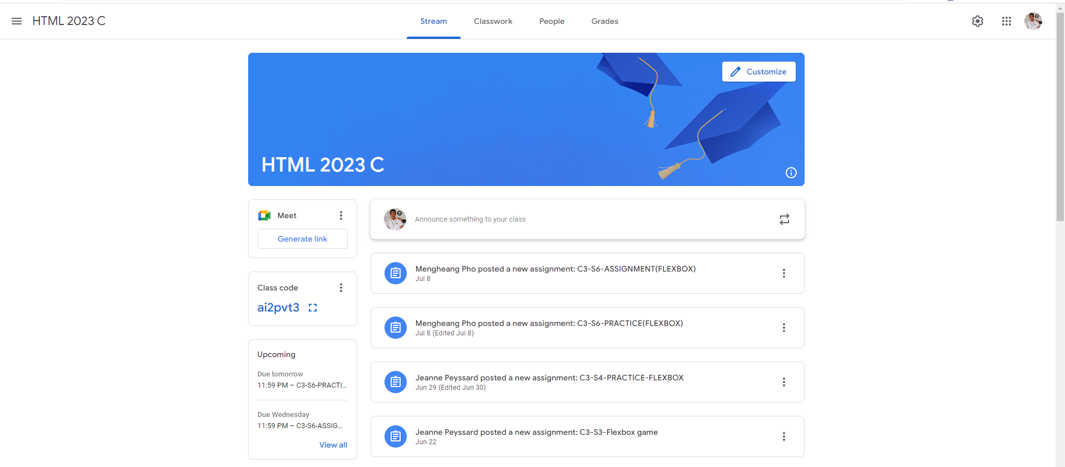
Identify root components of website below

Slide 2
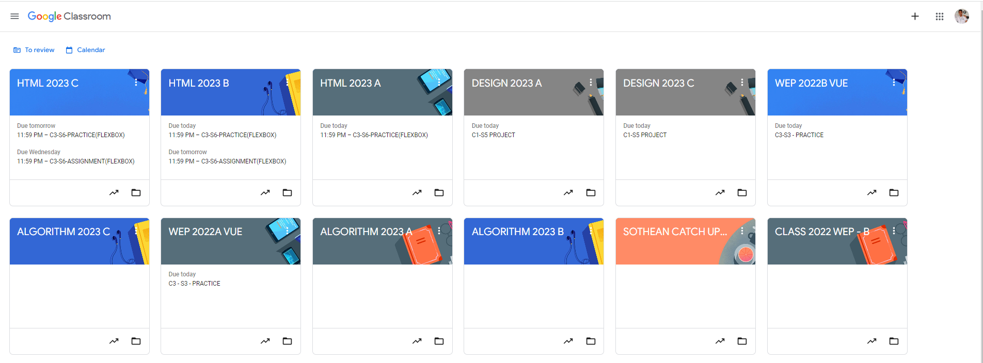
Root div
- Height: 100vh
content
nav
Flex: 0
header
Flex: 0
Flex: 1

Slide 3
Navigation bar
It contain drop down menu,Title, tabbed menu , setting, display another app button and profile picture and we apply
Flexbox justify content and align item.
Header
It contain title, customize button, and background picture we apply align item flex end for title and flex start for button
Main content
It have sidebar and in sidebar it have 3 div element
Div 1 contain logo link and menu
Div 2 contain two text and menu
Div 3 contain a small header and text and button to view more information
we apply flex direction colum for all above div
And also have Mian that include 5 dive element
First div it have user profile, input text and one button
Another Div it contain a logo describe div objective , text and menu
For this we apply flexdirection colum

